Slide 1
Infant Mortality
By Alamdar Qanoongo

Slide 2
What features we are taking from the dataset
What each feature is:
Material Race or Ethnicity: the race/ethnicity of the mother
Infant Mortality Rate: number of infant deaths under 1 year of age per 1000 live births
Neonatal Mortality Rate: number of infant deaths under 28 days of age per 1000 live births
Postneonatal Mortality Rate: number of infant deaths with age between 1 month-1 year of age per 1000 birth
Infant Deaths: number of infant deaths under 1 year of age
Neonatal Infant Deaths: number of infant deaths under 28 days of age per 1000 birth
Postneonatal Infant Deaths: number of infant deaths with age between 1 month-1 year of age per 1000 birth
Number of Live Births: number of live newborns

Slide 3
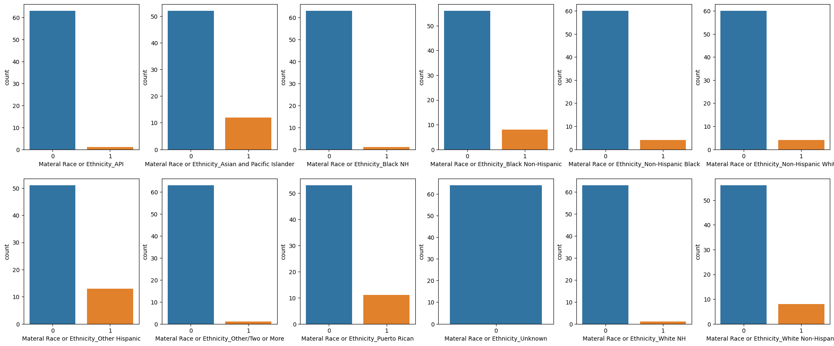
Number of Deaths per Race
1 - out of the infants that have died, that amount is the race of the infants that have died

Slide 4
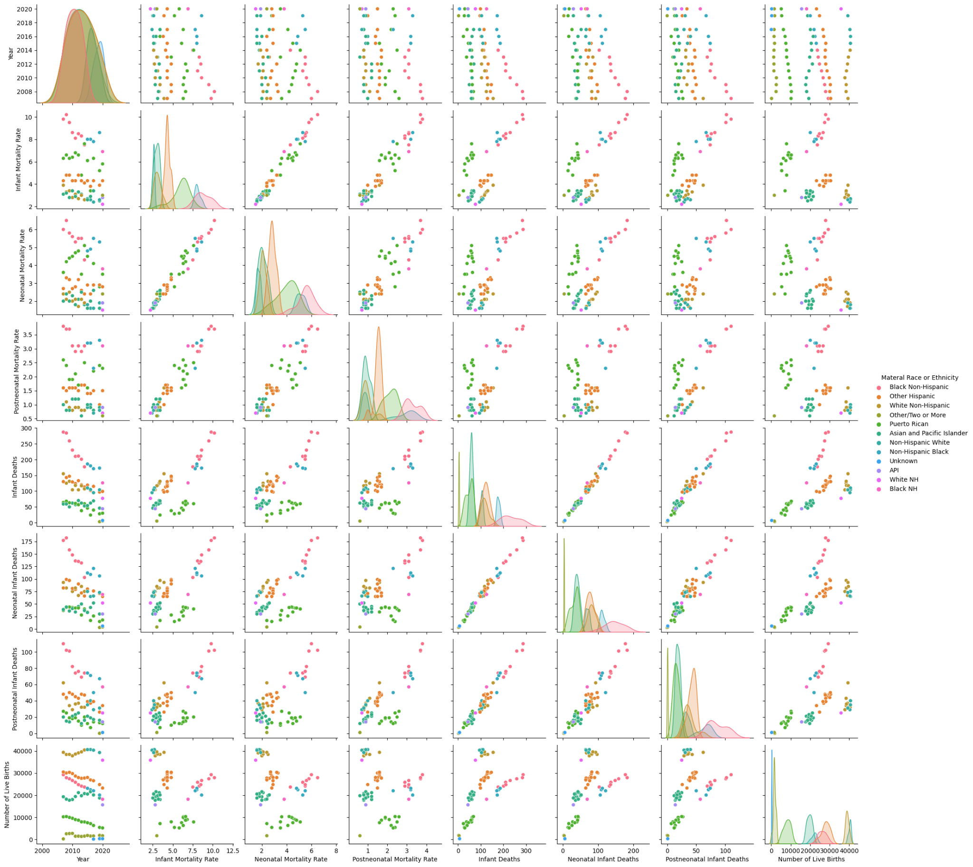
Relationship Between All Features, Separated by Race

Slide 5
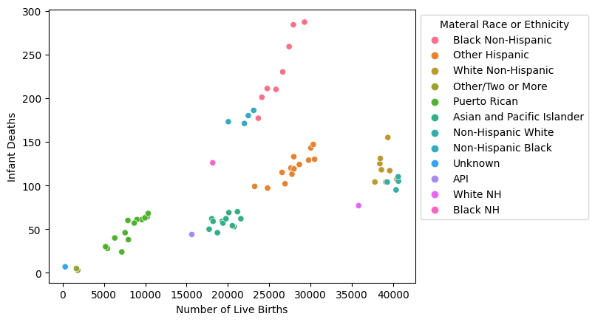
Number of Live Births and How Many Infants Died, Sorted by Race

Slide 6
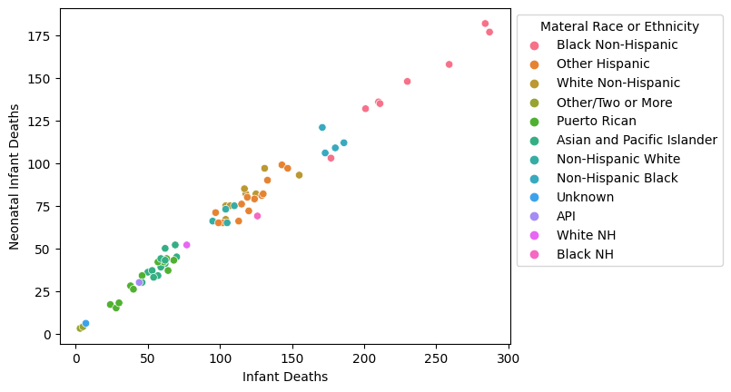
Infant Deaths vs Neonatal Infant Deaths, Sorted by Race

Slide 7
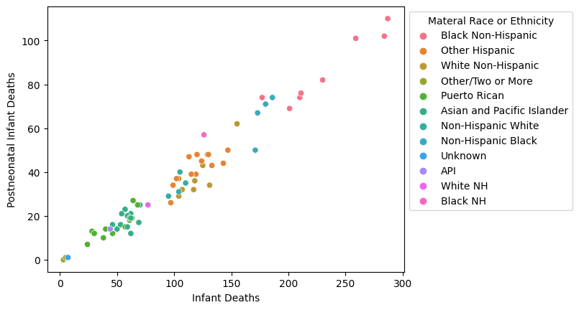
Infant Deaths vs Postneonatal Infant Deaths, Sorted by Race

Slide 8
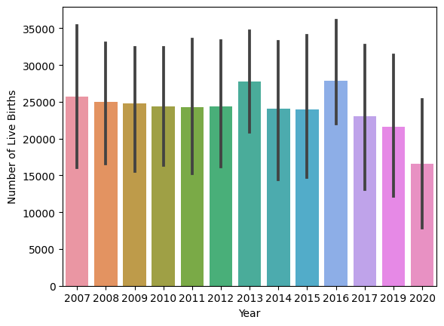
Number of Live Births per Year

Slide 9
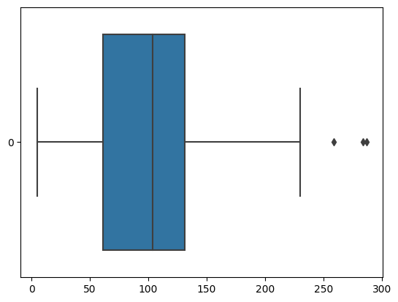
A Boxplot of Infant Deaths
count 64.000000
mean 110.125000
std 62.304552
min 5.000000
25% 61.000000
50% 104.000000
75% 131.500000
max 287.000000

Slide 10
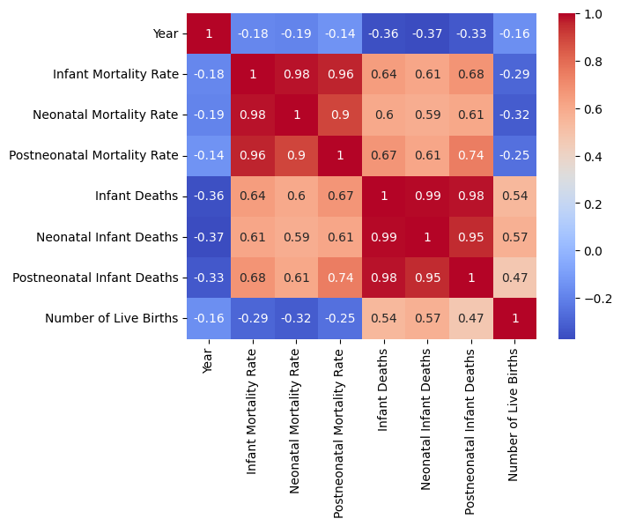
Heatmap Showing the Correlation Between Each Feature

Slide 11
Mathematical Equations
R2 Score: Mean Absolute Error: Mean Squared Error: 0.9891223787083043 5.673534488025778 57.19092833284607

